Slide 1
Group Project Workflows in GitHub
By Daniel Costantin
Notes:
Thanks again for having me
This is my second talk here at UWA

Slide 2

Before I begin
The views and opinions expressed in this presentation are that of my own and do not reflect that of my employers (past and present).
This presentation is based on my own experience, research and experimentation.

Slide 3

Upcoming hands on GitHub lab
Notes:
We are not doing this right now, but at the end of the presentation
Right after questions and answers
This was requested from students last year
I will help you with a hands on interactive GitHub tutorial
If you haven't already, please sit with your team as you can all contribute
You can do this individually, but it will be more fun working as a team
I have created a GitHub repository and I need your help

Slide 4

Who am I?
Daniel Costantin
Industry Experience
Tech Architecture Specialist at Accenture (10 months)
Senior Platform Engineer at Harvest Technology (1 year and 5 months)
Senior Associate at PricewaterhouseCoopers Australia (5 years)
Casual Academic (tutor) at Edith Cowan University (2 years)
Education
Master of Cyber Security – Edith Cowan University
Bachelor of Commerce (Business Information Technology and Systems) – Curtin University
Notes:
I have worked in IT for 7 years
Accenture = 10 months
Harvest Technology = 1 year and 5 months
PwC = 5 years and 3 months
4 years of Cyber Security work
1 year of development / integrations work

Slide 5
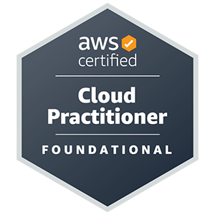





Who am I? (Continued)
Cloud Focused
Cyber Security Focused

Slide 6
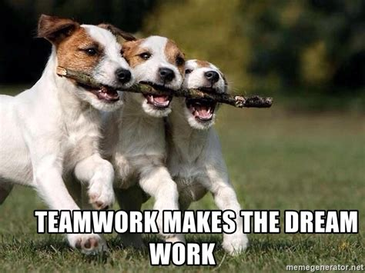

What this presentation will cover
Non-Technical GitHub Strategies
Technical GitHub Strategies
Notes:
My presentation will cover both non-technical (project management) and technical sides of GitHub
Both are VERY important to ensure the success of your project
I’d argue that the soft skills and project management skills are more important
I’m not going to go into super detail on different project management strategies in this presentation, such as
Waterfall
Scrum
Agile
For the most part, I am assuming you have already defined this

Slide 7
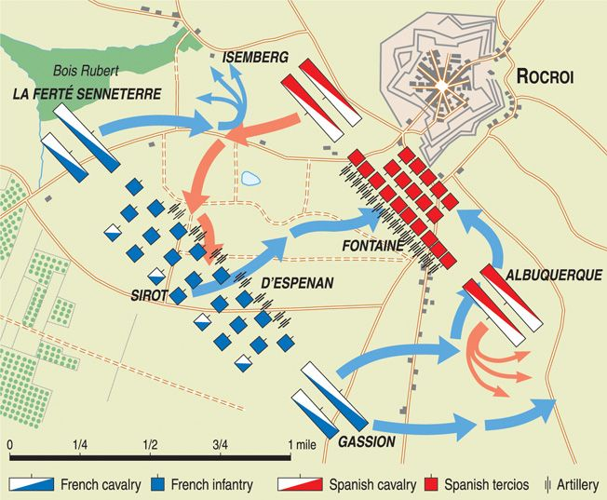
Project planning
By far the most important thing
Most common thing that is overlooked
Without proper planning, your project will fail!
Notes:
If you fail to plan, you plan to fail - Benjamin Franklin
If you give me eight hours to cut down a tree, I will spend the first six sharpening my axe – Abraham Lincoln
Most IT projects fail because of this
If you do this right, it is worth it’s weight in gold
Better direction
Better planning
Better understanding of your customers requirements
Improved morale
You may be able to better predict issues before they affect you
Try not to start coding ASAP, stop and have a think.
I spend a few hours or days thinking of my own personal projects before I write any code
Regardless of what project management strategy you use, sit down and have a think of how you will achieve your goals

Slide 8
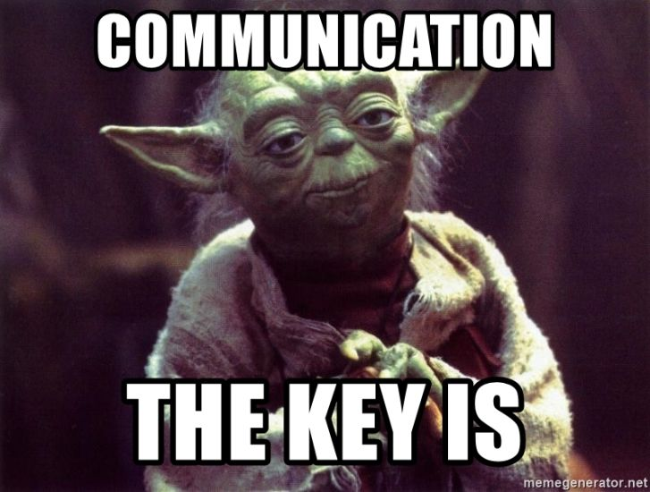
Team collaboration
Communicate, communicate, communicate!
Don’t be afraid to ask for help / clarification
This also includes communicating with your customer
Notes:
Also another reason why IT projects fail
Who else do you think you need to collaborate with besides your team?
If you want to be a project manager or solutions architect, communication is key
Communication is also just as important as a developer
You are all working towards a common goal, you will succeed or fail as one
If you need help, ask!
Just like Dominic Toretto says: Ride or Die
This also includes communication and collaboration with your customer
This is also worth it’s weight in gold
Think of the Amazon Leadership Principle – Customer Obsession
This also aligns with the Agile philosophy - Customer collaboration over contract negotiation

Slide 9



Managing Your Project
Notes:
Most tech companies I’ve worked with use Jira
You can integrate it with BitBucket to track code changes and ticket management
Some companies that are not mature / don’t have that much of a budget for Atlassian use Trello for ticket management
There are plenty more options out there, but these are the three I will be talking about the most today

Slide 10
Example Jira board – During Scrum
Notes:
See next slide for notes

Slide 11
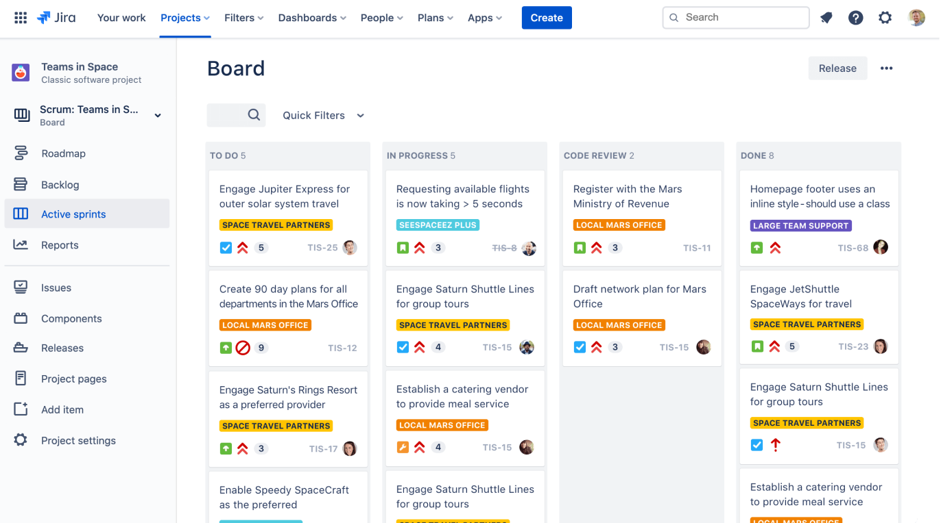
Example Jira board – During Scrum
Notes:
You can have as many or as few columns as you need
The most common ones I have seen are:
Backlog: Tasks that need to be addressed later
To Do: Tasks to complete as part of the current sprint
In Progress: What you are working on now
Blocked: Anything that you cannot work on in the sprint
In review: Code (such as PRs) or documentation that is under review
Testing: Manual or automated testing of a task
Done: Completed tasks
With Jira you can link these tickets with branches in BitBucket

Slide 12
Example Jira board – Backlog
Notes:
See next slide for notes

Slide 13
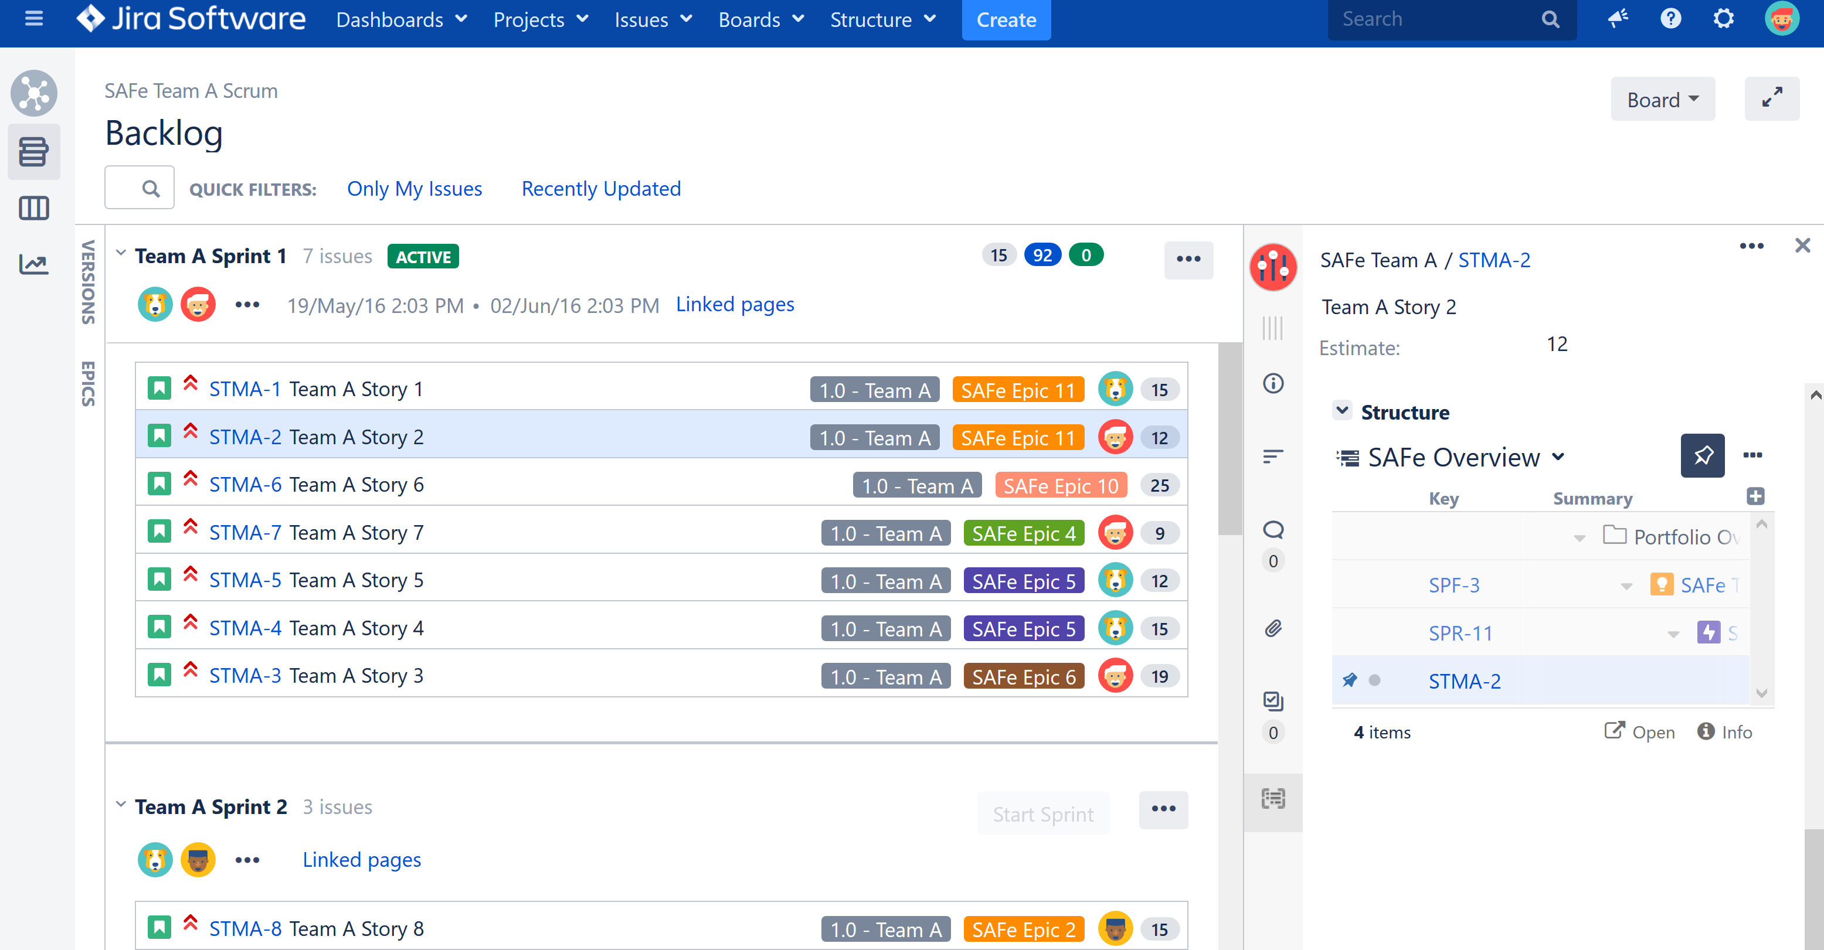
Example Jira board – Backlog
Notes:
This section you will only look at the beginning and end of your sprints
This gives you a high level overview of your backlog tasks

Slide 14
Example Trello board
Notes:
See next slide for notes

Slide 15
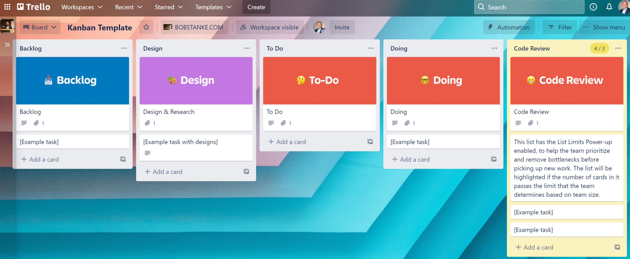
Example Trello board
Notes:
You might notice that this Trello board and the Jira board are very similar
Is the same thing, just different platform

Slide 16
Example GitHub Projects board – Standup
Notes:
See next slide for notes

Slide 17
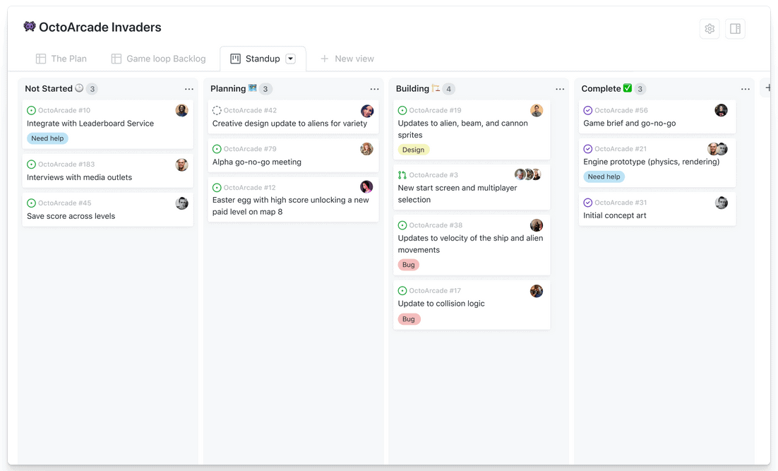
Example GitHub Projects board – Standup
Notes:
This is what I was more used to
Similar to Jira and Trello
You can also assign your tasks to issues and pull requests

Slide 18
Example GitHub Projects board – The Plan
Notes:
See next slide for notes

Slide 19
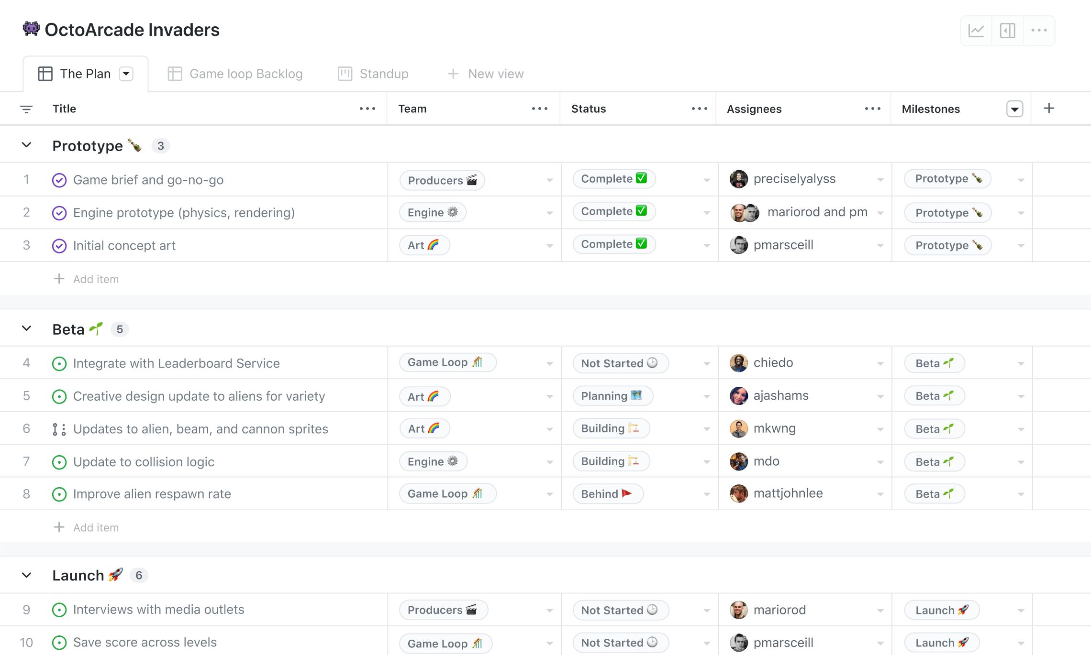
Example GitHub Projects board – The Plan
Notes:
This is a summary version of your tasks

Slide 20
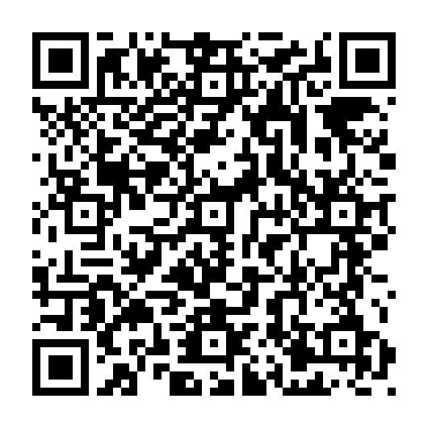
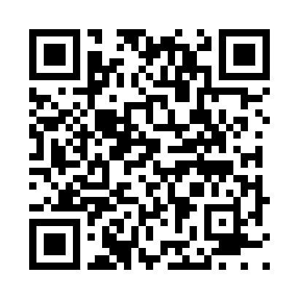
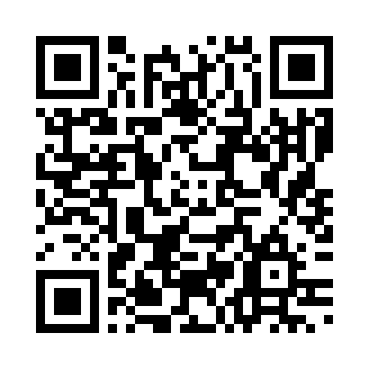
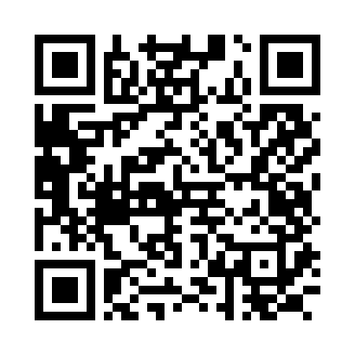
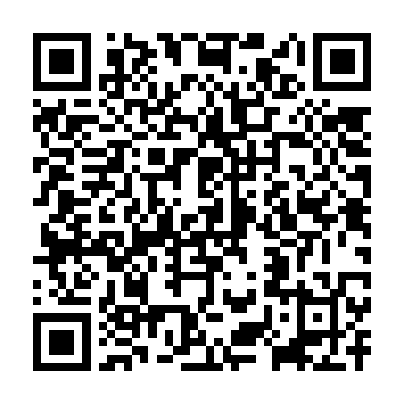
Helpful links
About GitHub Projects
The Dev Board
The KANBAN Board
Build a Barker MVP
35 Example Trello Boards
Notes:
URLs:
About GitHub Projects: https://docs.github.com/en/issues/planning-and-tracking-with-projects/learning-about-projects/about-projects
The Dev Board: https://trello.com/b/1Jz6SorC/the-dev-board
The KANBAN Board: https://trello.com/b/4wddd1zf/kanban-workflow
Build a Barker MVP: https://trello.com/b/R6DSCtsw/building-an-mvp-barker
35 Example Trello Boards: https://maybevaibhav.medium.com/best-35-trello-boards-for-you-to-see-and-get-inspired-6bf28b565616

Slide 21
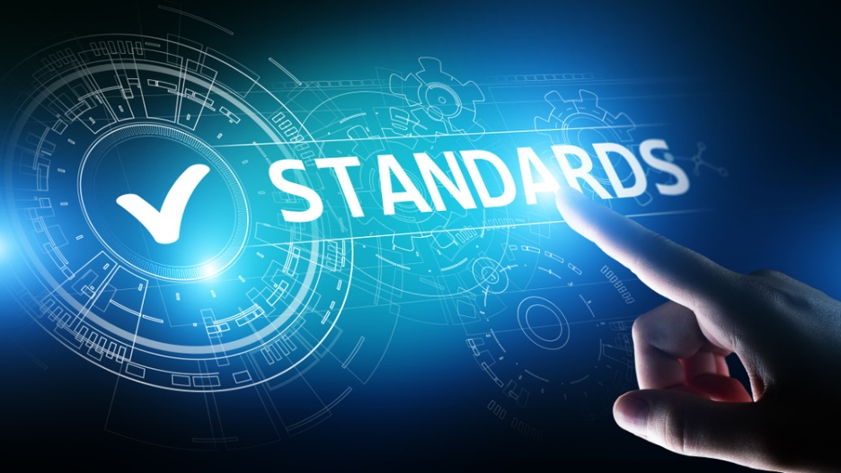
How standard are your standards?
Another important thing to consider before and during your project
Make sure you adhere to them
Add controls and processes to ensure you are following them
Notes:
There are many types of standards
It is always a good thing to have a think about some types of standards
Coding standards
Naming standards
Documentation standards
Professional conduct standards
Industry standards
Security
Compliance / Regulatory / Legal
I will mainly focus on coding and naming standards here
Did you ask your customer if there are any standards you need to follow?

Slide 22
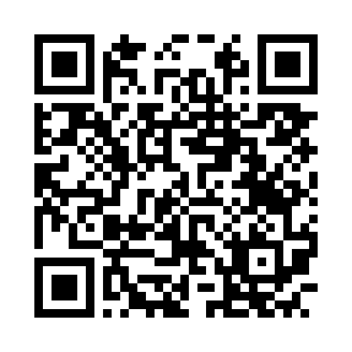
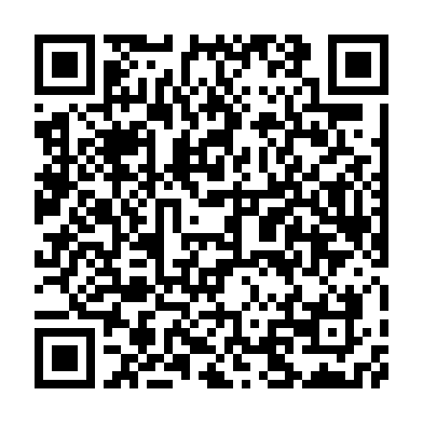
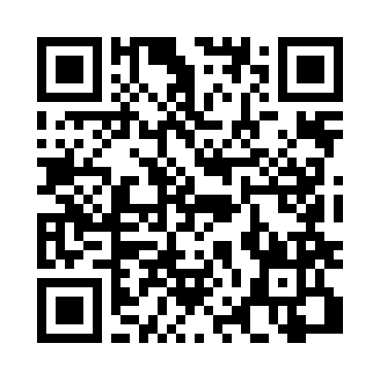
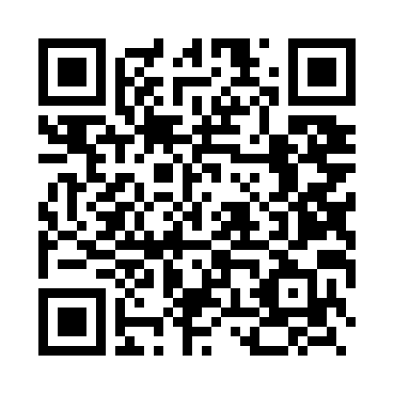
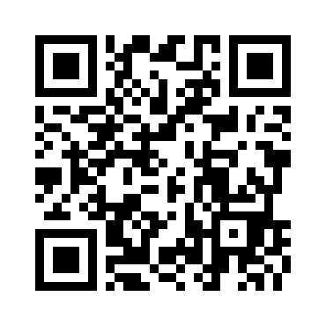
Coding standards
C Standards
C# Standards
C++ Standards
Node.js Standards
Python Standards
Notes:
I am not going into detail on any of them
These are some common coding languages that I have come across while working in the IT industry:
C
C#
C++
Node.js
Python (PEP 8)
These standards define things like:
How to name variables, classes, functions etc.
How to format and structure your code
Length of lines
Indentation
Ways of commenting
Using external libraries / dependencies
Better ways of writing code
I have seen developers refuse to read PRs if you don’t follow these standards
This can also apply for unit test coverage
I will talk later in this presentation on adding automated tooling that can detect code that does not follow the standard
Most mature companies (should) have these already documented somewhere
URLs
C Standards: https://www.gnu.org/prep/standards/html_node/Writing-C.html
C# Standards: https://learn.microsoft.com/en-us/dotnet/csharp/fundamentals/coding-style/coding-conventions
C++ Standards: https://google.github.io/styleguide/cppguide.html
Node.js Standards: https://github.com/felixge/node-style-guide
Python Standards: https://peps.python.org/pep-0008/

Slide 23
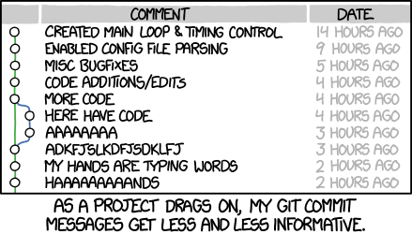
Can we all agree to commit?
Did you know, there are standards for git commit messages as well?
Proper git commit messages can help when:
Reviewing or retrieving old versions of code
Reviewing other developers code
Notes:
Standards also apply to your commits
You can use git or other automation tools to search through git messages
A good git commit message should be short but descriptive

Slide 24
Examples of good commit messages
git commit -m “Added tax calculation function”
git commit -m “Added tax calculation unit tests”
git commit -m “Imported common libraries”
git commit -m “Fixed logic evaluation bug”
git commit -m “feat: example hello world api endpoint”
git commit -m “feat(1234): added authentication logic to api endpoint”
git commit -m “documentation(5432): added docker build and run commands”
Notes:
This is the CLI command to create commits
The last three commits follow the Conventional Commits standard

Slide 25
Examples of bad commit messages
git commit -m “added stuff”
git commit -m “test”
git commit -m “test”
git commit -m “test”
git commit -m “a”
git commit -m “b”
git commit -m “c”
git commit –m “”
Notes:
Don’t do this
I have had managers above me do this

Slide 26
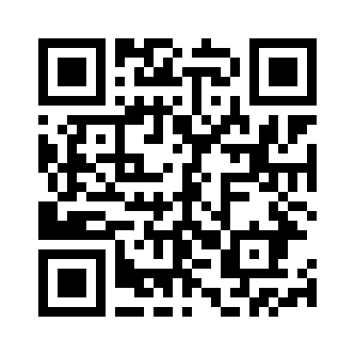
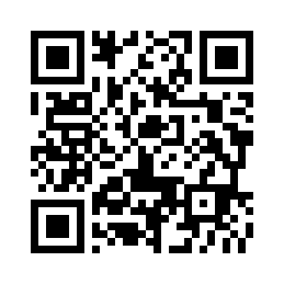
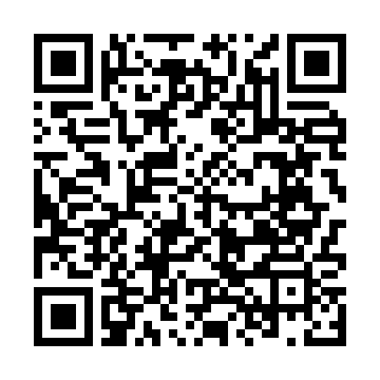
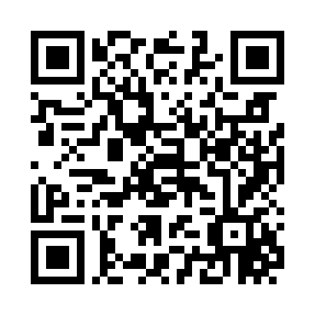
Git standards references
Amazon Web Services GitHub Repositories
Conventional Commits
Git commit message convention
Microsoft GitHub Repositories
Notes:
The middle two QR codes are related to git commit standards
The first and last one are two (of many) GitHub repositories
Have a look at other public GitHub or GitLab repositories and see how others do things.
URLs:
Amazon Web Services GitHub Repositories: https://github.com/orgs/aws/repositories
Conventional Commits: https://www.conventionalcommits.org/
Git commit message convention: https://dev.to/i5han3/git-commit-message-convention-that-you-can-follow-1709
Microsoft GitHub Repositories: https://github.com/orgs/microsoft/repositories

Slide 27
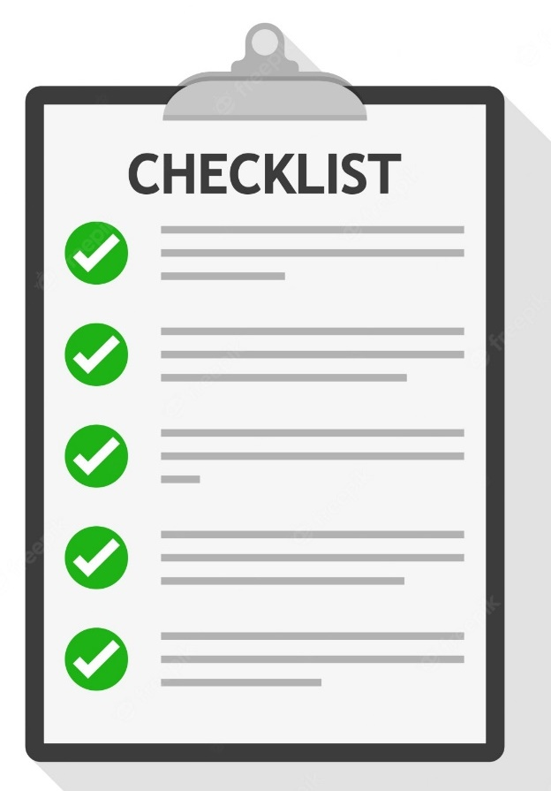
Do you have a code review process?
What checks (if any) will you include in pull requests?
What merge rules (if any) will you include in pull requests?
Do all pull requests need to be reviewed or only certain branches?
What if a developer is not familiar with a particular language? What happens to approvals?
Is there a process if you need to merge a pull request immediately?
Notes:
By code review, I mean your pull / merge requests
I will go into further explanation of these rules and checks later
Also, do you have a process for an expectation to these rules?
What happens if you need to make an emergency change or update and bypass your checks / rules?
Also, how do you document this?

Slide 28

GitHub Issue and Pull Request templates
Did you know, you can create custom templates for Issues and Pull Requests?
Makes it easier for all developers to follow the same style / format when creating Pull Requests or reporting Issues
Notes:
My GitHub repository has some example templates you can have a look at
You can also try and find other public GitHub repositories and see what others are doing
There is no right or wrong way to do this
It can also help you like a checklist of activities before submitting a Pull Request for review
You can also have separate templates for different types of Pull Requests
Feature only Pull Request template
Documentation only Pull Request template
Catch all Pull Request template

Slide 29
Example Pull Request template
Notes:
See next slide for notes

Slide 30
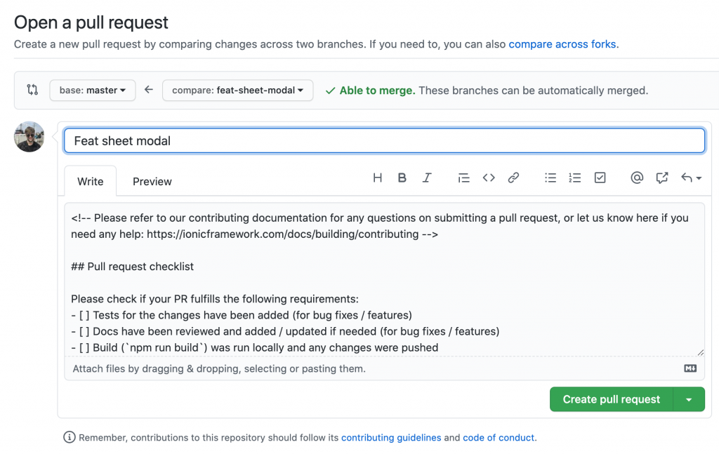
Example Pull Request template

Slide 31
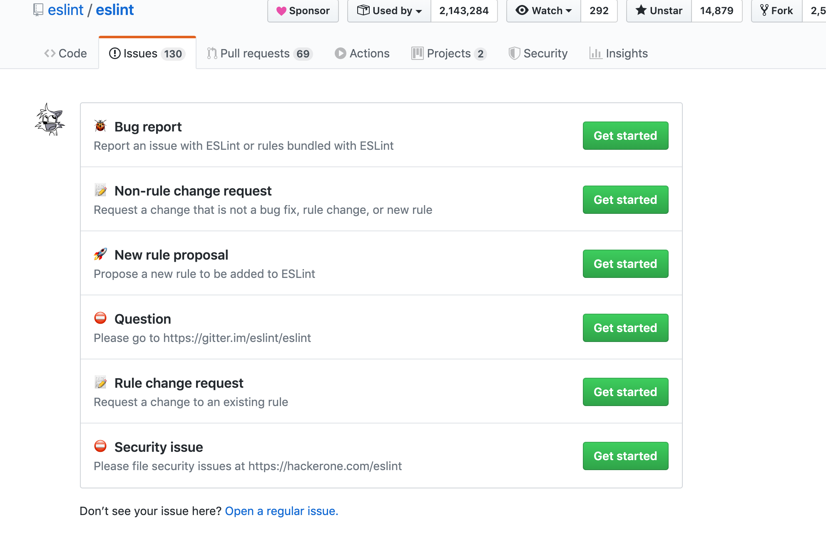
Example Issues template – Part 1
Notes:
eslint is a good tool to use to enforce linting such as:
Coding standards and formatting
Fix potential code smells

Slide 32
Example Issues template – Part 2
Notes:
See next slide for notes

Slide 33
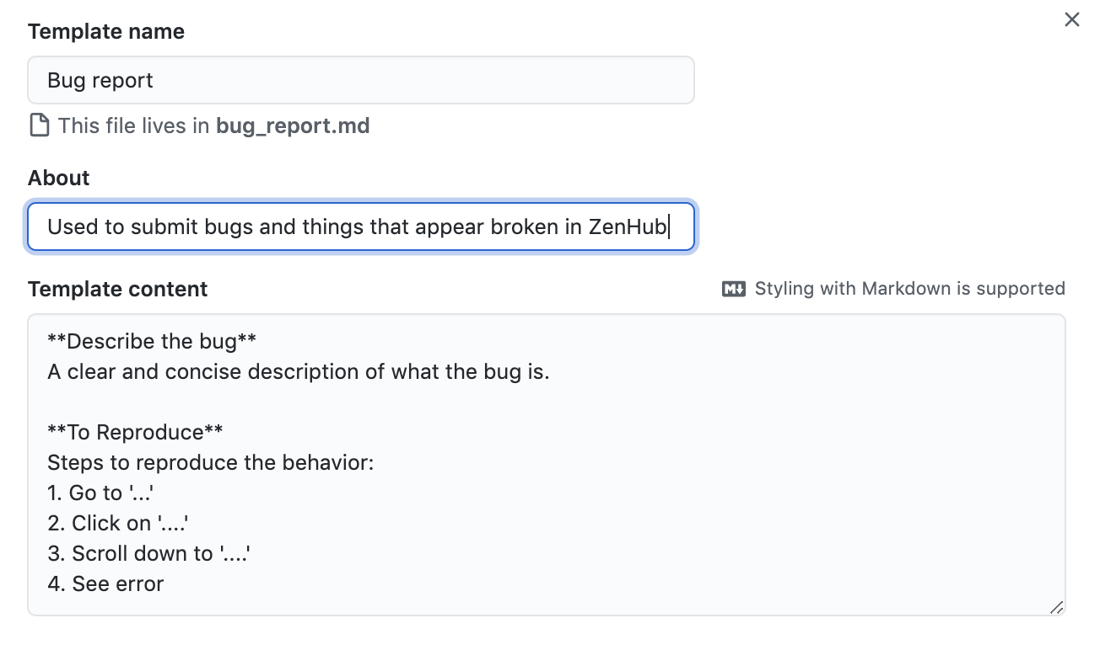
Example Issues template – Part 2
Notes:
As you can see, it includes some common headers for describing a bug and replicating it
Helps incentives developers to add the required detail / documentation

Slide 34
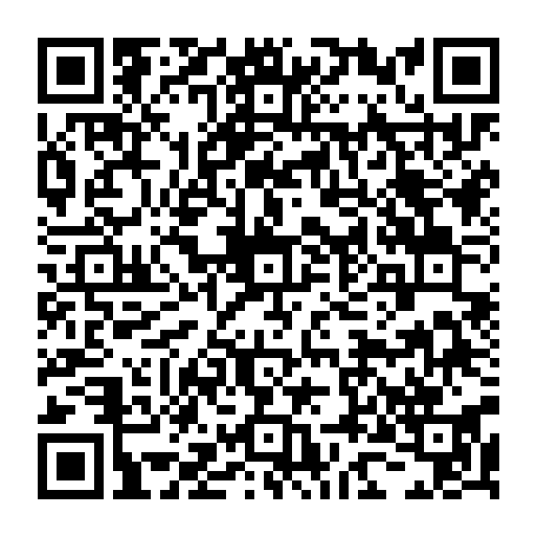
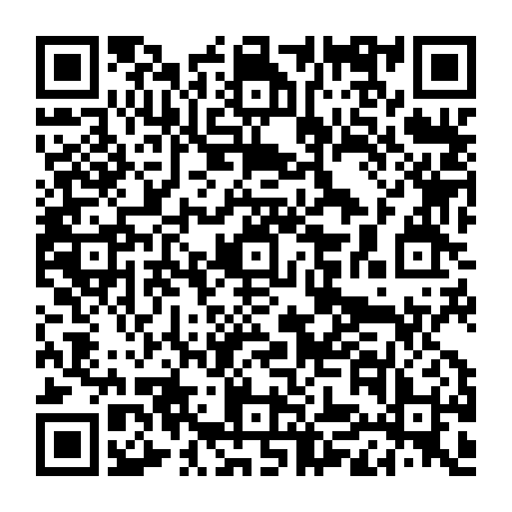
Creating GitHub templates
Configuring GitHub Issue Templates
Configuring GitHub Pull Request Templates
Notes:
URLs:
Configuring GitHub Issue Templates: https://docs.github.com/en/communities/using-templates-to-encourage-useful-issues-and-pull-requests/configuring-issue-templates-for-your-repository
Configuring GitHub Pull Request Templates: https://docs.github.com/en/communities/using-templates-to-encourage-useful-issues-and-pull-requests/creating-a-pull-request-template-for-your-repository

Slide 35
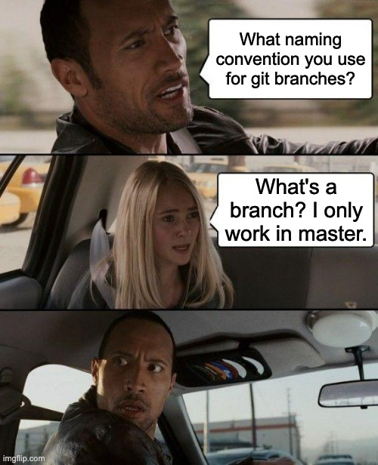
Git with the flow
Provides better control over your code
Two ways to do this:
Gitflow
Trunk based
Very important to your health and sanity
Notes:
Quick show of hands, who has heard of or is familiar with Gitflow?
I have used both Gitflow and Trunk based development
Trunk based development is more popular

Slide 36
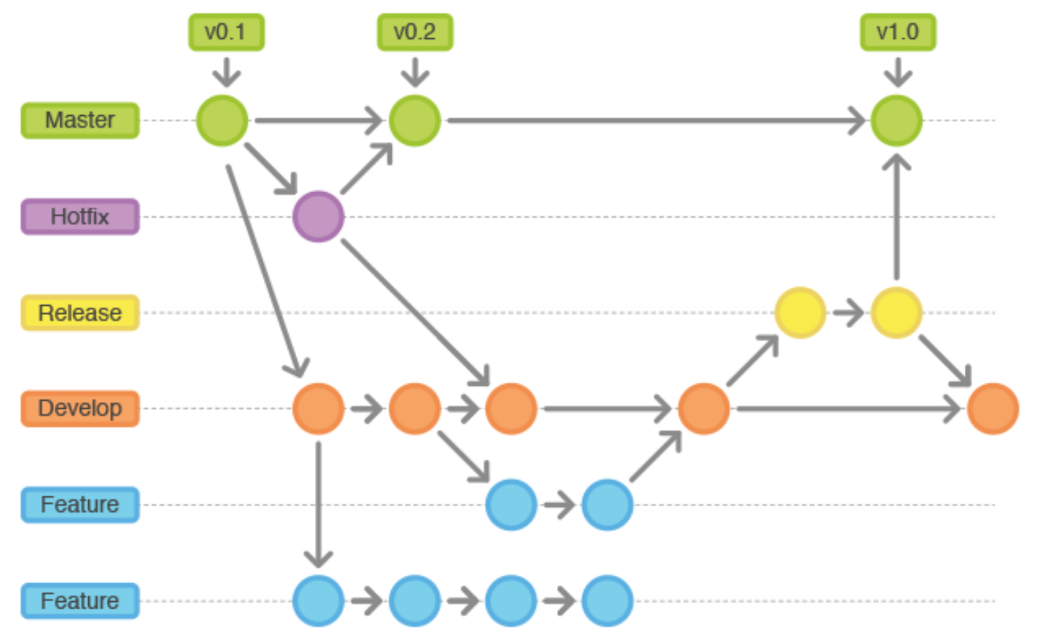
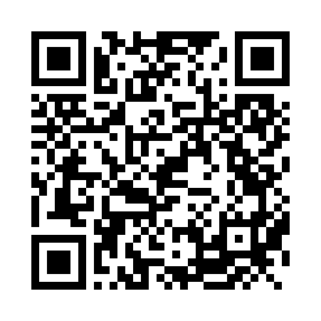
Gitflow 101
Animated Gitflow
Notes:
Animating this is too hard
See the next slide for the URL
You can configure CI / CD pipelines per branch

Slide 37
Gitflow 101
Animated Gitflow
Notes:
Animating this is too hard
Instead, I will use this URL: https://veerasundar.com/blog/gitflow-animated/
You can configure CI / CD pipelines per branch

Slide 38
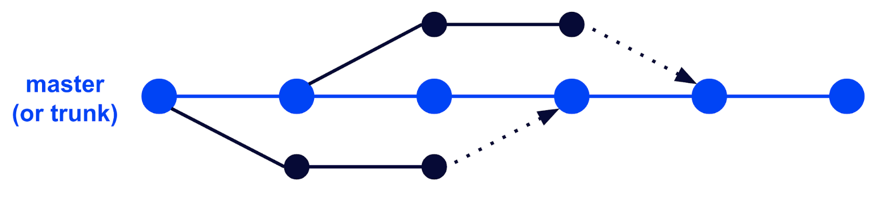
Trunk based development
Notes:
The idea is to branch off master / main, make small changes and merge it back as soon as possible
This is more common in the industry
Have a single source of truth
You can configure CI / CD pipelines per branch

Slide 39
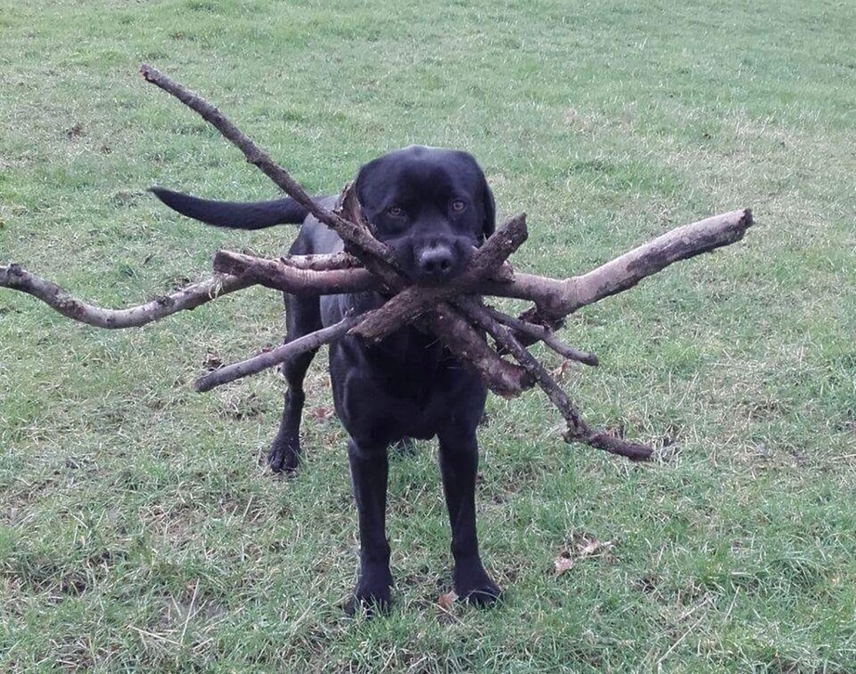
Additional git branches
bugfix/
documentation/
emergency/
experimental/
feature/
hotfix/
security/
You can use whatever you like, but you must agree as a team on what branch names to use and their purpose
Notes:
There is no right or wrong way to use branches
The ones I’ve used the most are:
bugfix/
documentation/
experimental/
feature/
Do whatever you like, but make sure you all agree on their usage

Slide 40
Examples of good branches
git checkout –b feature/upload-profile-picture
git checkout –b feature/containerise-application
git checkout –b bugfix/json-parsing-issue
git checkout –b release/codename-alpha
git checkout –b hotfix/incorrectly-declared-class
git checkout –b experimental/additional-encryption-ciphers
git checkout –b refactor/authentication-evaluation
git checkout –b documentation/pipeline-instructions
Notes:
These are the CLI commands to create a new branches

Slide 41
Examples of good branches (continued)
git checkout –b feature/ID-1234/add-product-api
git checkout –b feature/ID-5432/list-product-api
Notes:
These are the CLI commands to create a new branches
I have not seen people do feature branches this way, but it could work.

Slide 42
Examples of bad branches
git checkout –b stuff
git checkout –b stuff2
git checkout –b test
git checkout –b feature/implement-iso-compliance-control-page-10-control-27
Notes:
These are the CLI commands to create a new branches
You can incorporate GitHub actions to alert you if you try to create a branch that does not follow your convention / standards
The last dot point is way too long
Branch names should not be overly long

Slide 43
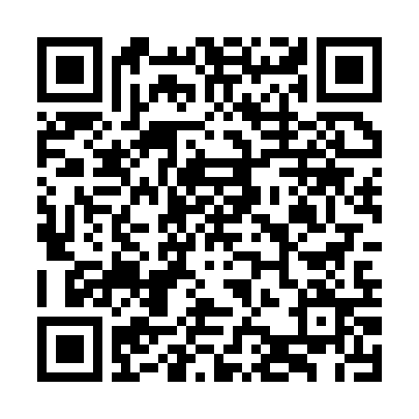
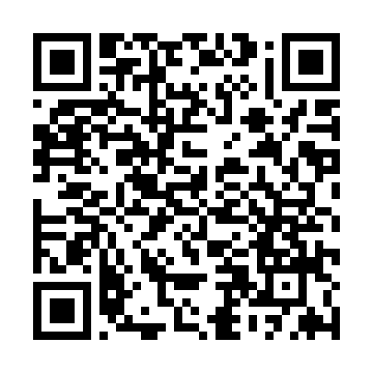
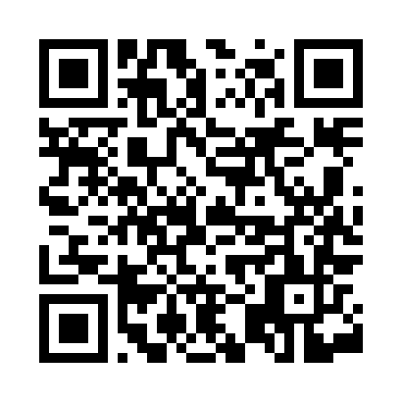
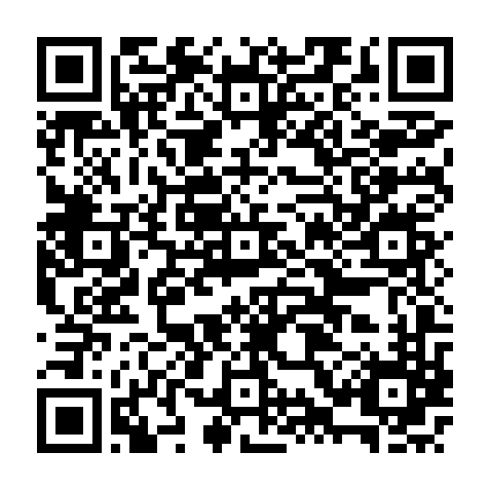
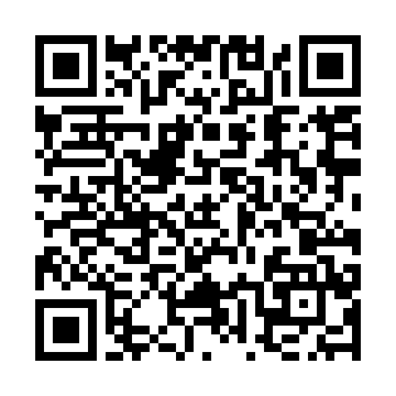
Git branching references
Git Branching Naming Convention Best Practices
Gitflow Workflow
GitHub Branching
GitHub Branching Best Practices
Trunk-based Development VS Gitflow
Notes:
That’s cool and all, but why should I care?
The next slides show the power of pipelines and git branches
URLs:
Git Branching Naming Convention Best Practices: https://codingsight.com/git-branching-naming-convention-best-practices/
Gitflow Workflow: https://www.atlassian.com/git/tutorials/comparing-workflows/gitflow-workflow
GitHub Branching: https://gist.github.com/digitaljhelms/4287848
GitHub Branching Best Practices: https://stackoverflow.com/questions/2006265/is-there-a-standard-naming-convention-for-git-tags
Trunk-based Development VS Gitflow: https://www.toptal.com/software/trunk-based-development-git-flow

Slide 44
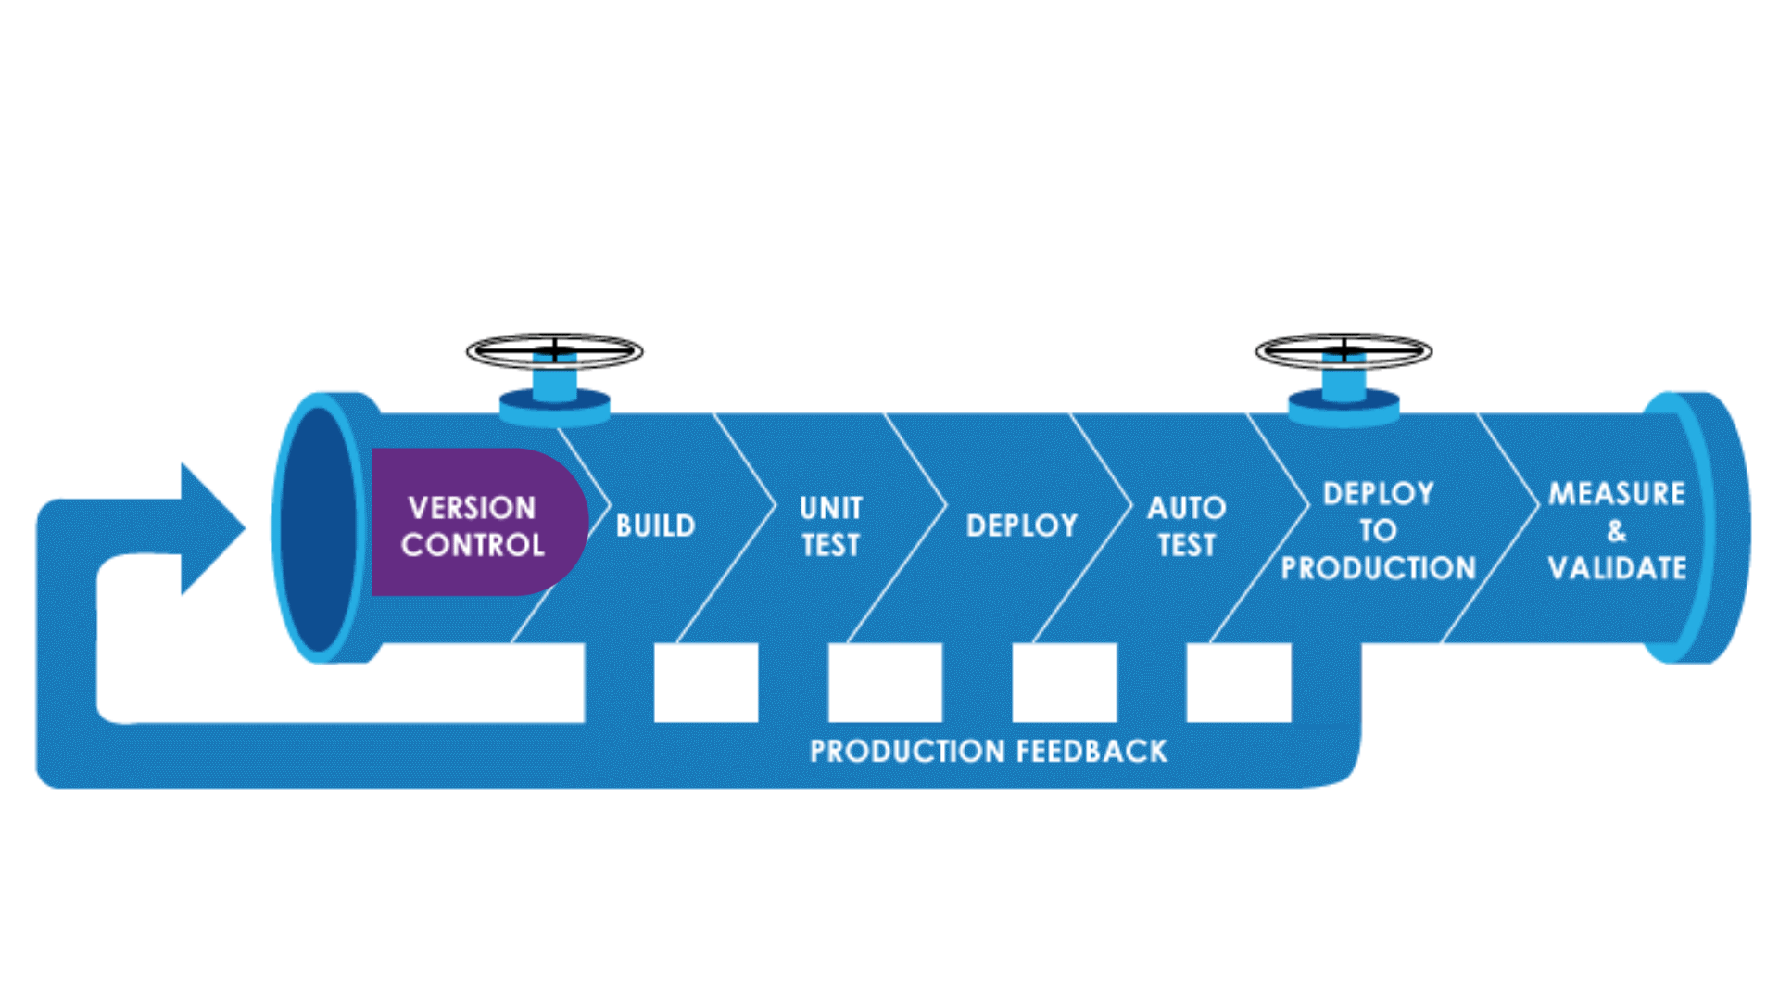
Branches and CI / CD pipelines
CI / CD = Continuous Integration and Continuous Delivery / Continuous Deployment
Part of the DevOps mantra
Automate a much as you can!
Provides instant feedback to developers
Innovate faster!
Notes:
CI / CD = Continuous Integration and Continuous Delivery / Continuous Deployment
Essentially this is shipping out quality code as fast as you can to your customers
Ideally you want to have an automated process to build, ship and run your code
This can include:
Running unit / integration tests
Compiling code
Deploying to an environment
You should run unit tests during your pipeline
This will provide instant feedback if anything breaks
If the pipeline fails, it stops and no new code is deployed

Slide 45
Example CI / CD pipelines with GitHub
Notes:
See next slide

Slide 46
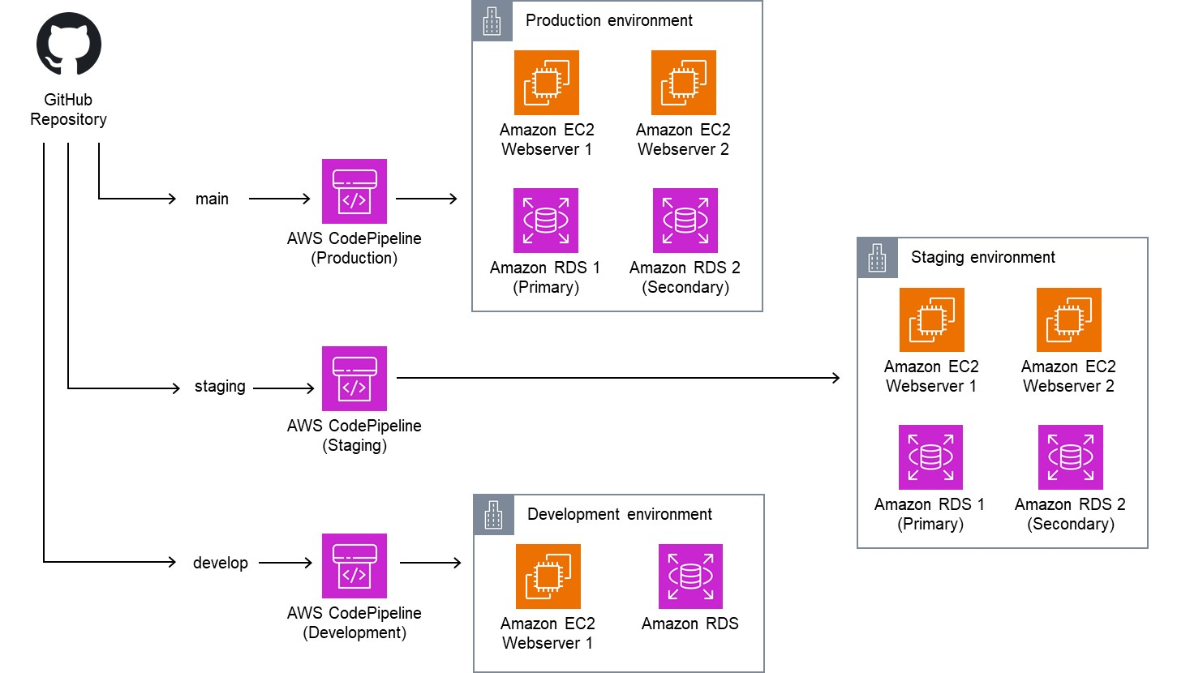
Notes:
Since I have experience with AWS, I have used their architecture diagrams
But the same idea can be applied with other CI / CD pipeline tools such as:
Azure DevOps pipelines
Jenkins
You can add manual approval stages as part of your pipelines
This you should do for production environments

Slide 47
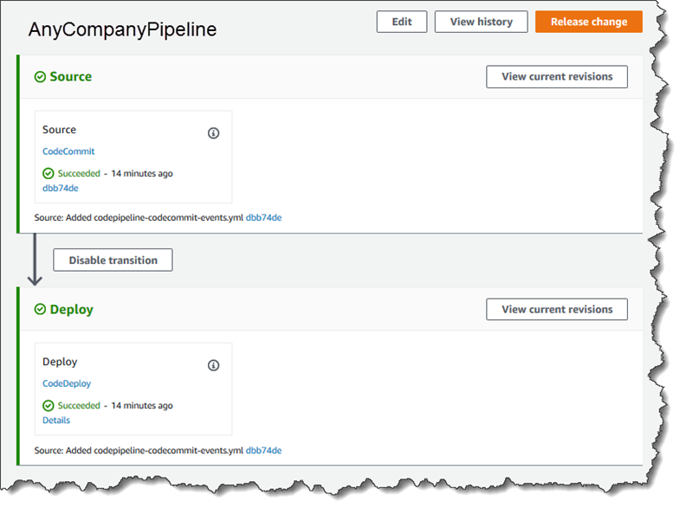
AWS CodePipeline – Success
Notes:
An example image of a successful pipeline execution
You can have as many stages as you like
This is a short one of two stages

Slide 48
AWS CodePipeline – Failure
Notes:
Please see next slide for notes

Slide 49
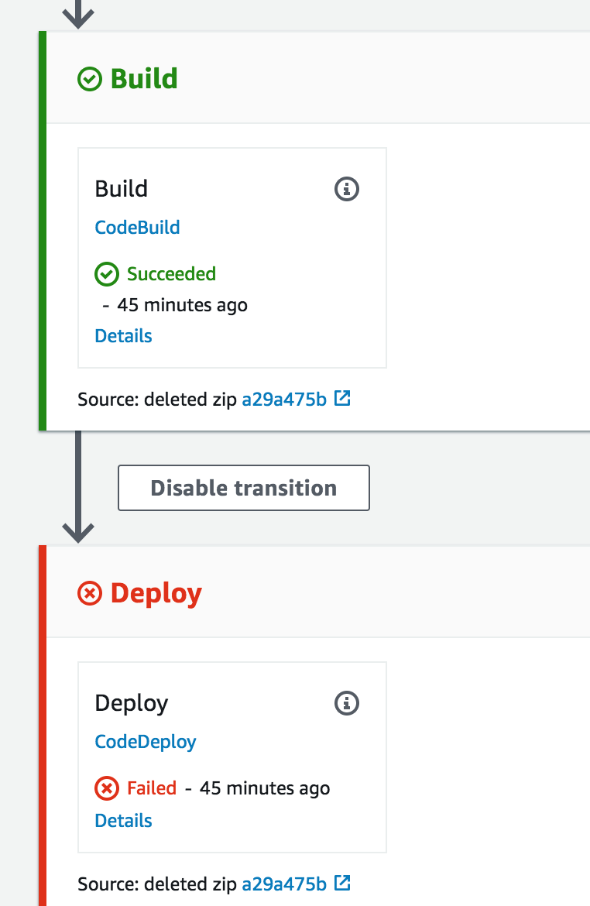
Notes:
An example image of an unsuccessful pipeline execution
The good thing is, if the pipeline fails it will stop at the stage of failure
You can also configure your pipelines to alert / send messages on failure
Messages in Microsoft Teams
Slack messages
Text messages
Send an email to yourself
When we do the live demo, you will see my pipeline in action

Slide 50

Tag, you’re it (with git)
Similar to commits, you can also tag your code
Normally done with stable code that is ready to be shipped / deployed
Common tagging methods:
v1.2.3
1.2.3
You can revert back to these tags in the future:
git checkout v1.0
V1.0
Notes:
You can tag any commit in Git
Normally should only tag commits of stable code for release
v1.0
v1.1
v1.2
You would want to revert back to tags when:
Bugfixing older versions of the code
Reverting back to a stable release
Releasing alpha / beta builds

Slide 51
Gitflow 101
Animated Gitflow
Notes:
Remember this?
You can tag whatever commit you want, but normally people tag on the master / main branch only

Slide 52
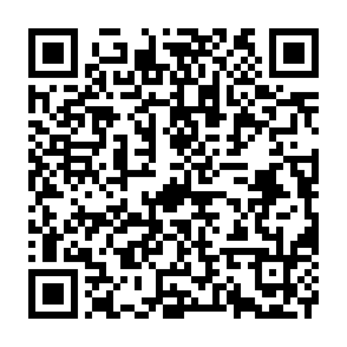
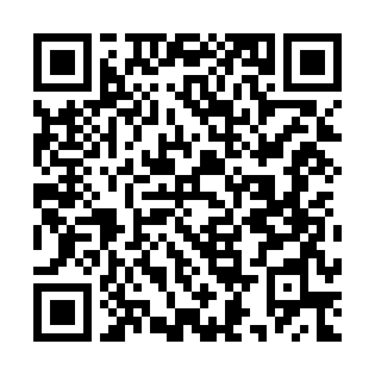
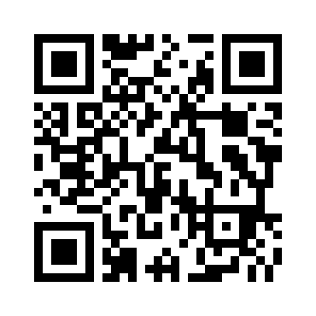
Git tag references
Git tag naming convention
Git tags
What are git tags
Notes:
URLs:
Git tag naming convention: https://stackoverflow.com/questions/2006265/is-there-a-standard-naming-convention-for-git-tags
Git tags: https://www.atlassian.com/git/tutorials/inspecting-a-repository/git-tag
What are git tags: https://www.hatica.io/blog/git-tags/

Slide 53
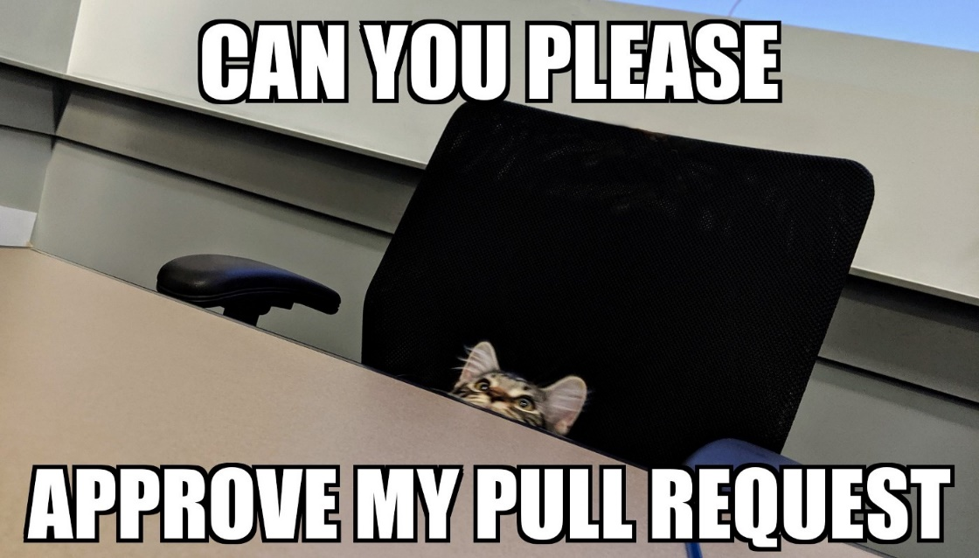
Submitting your Pull / Merge Request
There is no right or wrong way to create pull requests
You can reference commits, issues and close issues when a pull request is merged.
Make sure you delete your branch once the pull request has been merged!
Notes:
Pull Request (PR) and Merge request are the same thing
GitHub = Pull Request
BitBucket = Pull Request
GitLab = Merge Request
As mentioned before, you can use your templates to help pre-populate your submission

Slide 54
Bad Pull Request example
Notes:
See next slide for notes

Slide 55
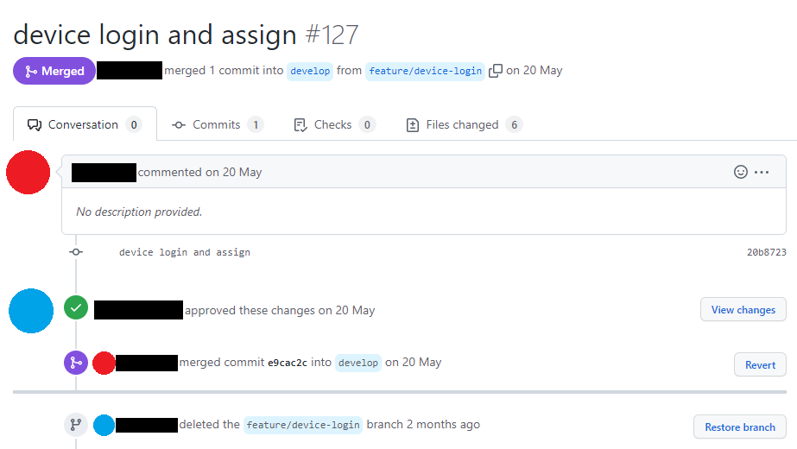
Bad Pull Request example
Notes:
I have redacted my former colleagues names and avatars
There is no right or wrong way to make a PR
But you should at a minimum add a description explaining what you have done as part of your work
This will help you if you need to refer back to this PR in the future

Slide 56
Good Pull Request example
Notes:
Please see next slide for notes

Slide 57

Notes:
I have redacted my name and avatar
There is no right or wrong way to make a PR
You can add “Closes” which will automatically close GitHub issues once the PR is merged

Slide 58


Pull Request controls / checks
Notes:
You can add GitHub actions to run tests / checks anytime
On pushes
On pull requests
On tags
On issues
Administrators can override this and still merge code, be careful!
Remember about establishing a process if you ever need to bypass this?
The idea with these controls / checks is to maintain code quality

Slide 59

Pull Request courtesy
Pull requests are opportunities for you to learn and grow as a developer
It is not a blame game or “my code is better than yours”
Call out anything that is clearly bad
Be open to improvements and constructive criticism
Notes:
If the code works but is not optimised or you might have a better way to do it, make a new PR.
Anything bad can include (but not limited to):
Committed passwords or secrets
Programming logic that is incorrect
Unused code

Slide 60

Resolving merge conflicts
Talk to your fellow developers!
Refrain from “I know what I’m doing, I don’t need to ask for help”
If you make small changes and merge often, you can avoid this
Don’t make too many different changes in your branches
Notes:
Merge conflicts are going to happen!
You should have an idea who is working on your code or the main contributors
You can use the git blame command to help work out who
If you do this wrong, you might break other people code
Or, remove their code
If you do proper planning and merging, you can avoid this
Be careful running project wide coding linters and formatters, it could cause merge conflicts
Don’t make too many different changes in your branches.
If you are working on a feature/ branch to add some new functionality and you notice some other code (outside your work) that has a logic bug or not conforming to coding standards, do not fix it in your branch
If you notice these things, make a new branch and address it there

Slide 61
Resolving merge conflicts – Commands
git checkout feature/image-resizer
git pull origin develop
Make edits to the affected file(s)
git add --all
git commit -m "Resolved merge conflicts"
git push
Notes:
These are the commands I use to resolve merge conflicts
Be careful using git add --all
Ideally, you should manually stage your file(s)
The next slide shows how VS code identifies files with merge conflicts
I will try and do this in the lab too

Slide 62

Resolving merge conflicts – VS Code
Notes:
VS code will show you all file(s) that have merge conflicts
You have a choice to either:
Accept the current changes (HEAD)
Accept the incoming change (new code)
Accept both
Override it and add new code

Slide 63

Is your commit worthy?
We have talked about git commit and commit messages
git relies heavily on the developer
What happens if you commit the following?:
Passwords or API keys
Failing unit tests
Code that is not compliant to coding standards
You can configure Git Hooks to perform actions / checks on certain actions
Notes:
By default, the git commit command has no logic to prevent uses from committing the following:
Secrets (passwords or API keys)
Code that does not work
If you do accidently or deliberately upload sensitive code to a remote repo, there is a lot of work required to get rid of it
Delete it from git
Rotate secrets
Inform users
Alert a security / SOC team
You can configure git to use Git Hooks to perform additional logic before performing a certain action
Running code linting and formatting scans before code is committed
Checking that branches are name appropriately
Running unit tests before code is committed
This can help maintain quality of your code

Slide 64

Git pre-commit hook – Example 1
Notes:
This is using Husky
You can configure Husky to either:
Alert and stop
Alert and fix

Slide 65

Git pre-commit hook – Example 2
Notes:
This is using pre-commit

Slide 66


Git hook software
pre-commit
Husky
Notes:
I’m sure you can Google many other pre-commit tools
These are just two examples
URLs:
Husky: https://typicode.github.io/husky/
pre-commit: https://pre-commit.com/

Slide 67

Lights, camera, GitHub Actions!
Similar to your CI / CD pipelines, did you know you can also get GitHub to perform some automations?
For example:
Run unit tests
Build Docker containers
Perform code review(s) / linting
Enforcing code standards / formatting
Update ticketing systems
Perform security dependency scanning
Notes:
You can configure your own or pre-built GitHub actions to do some automations
I have build my own before
My GitHub repo includes some of these actions
There might be limitations with some of these third party tools such as:
Public vs private repos
Licenses
Pricing

Slide 68




Example GitHub Actions apps
Notes:
You can configure your own or pre-built GitHub actions to do some automations
These are just some of the many out there
I selected these at random

Slide 69

Example GitHub Actions – Workflow 1
Notes:
This is an example workflow I found online
These builds (artefacts) can be located either:
GitHub
Website for download
Deployed as part of an automation process

Slide 70

Example GitHub Actions – Workflow 2
Notes:
This is a workflow I created for the previous presentation
When new code is merged on the main branch, it will automatically trigger the following:
GitHub action to create a new Docker container and upload it to Docker Hub
AWS CodePipeline pipeline to build and deploy the Docker container to an Amazon EC2 instance

Slide 71



GitHub Actions references
GitHub Actions
GitHub Actions Documentation
GitHub Actions Marketplace
Notes:
URLs:
GitHub Actions: https://github.com/features/actions
GitHub Actions Documentation: https://docs.github.com/en/actions
GitHub Actions Marketplace: https://github.com/marketplace

Slide 72

Adding DevSecOps to your project
Notes:
DevOps = Development and Operations
DevSecOps = Development, Security and Operations
It is worth enabling this as part of your repository so you can be alerted to any security vulnerabilities of code dependencies
This is not from any of my repositories, I found this online
Ideally, you should include cyber security from the beginning if your project

Slide 73

Example Dependabot alerts
Notes:
These were vulnerabilities from my presentation I did last year
I did address these, so my code is no longer vulnerable!

Slide 74
Dependabot Pull Request
Notes:
See next slide

Slide 75

Dependabot Pull Request
Notes:
Depedabot will automatically create a new branch and Pull Request for you
Don’t blindly merge the PR straight away
Make sure all your unit tests and integration tests work

Slide 76

My final tips and tricks
Make sure you put some time aside to plan your work!
Make sure your Proof of Concept (PoC) works first!
Keep it simple!
Get feedback from your customer
Communicate as much as necessary
Raise issues / concerns early
Notes:
Because I am a nice guy, here are my final tips and tricks to be a good developer and project manager
Make sure you set some time aside to plan before you jump straight into the code
Start small = PoC
Make sure your PoC / idea works before you start anything else!
Always, get feedback from your customer as soon as you can
Get constant feedback throughout the project
If things do not make sense, ask for help / clarification
Keep asking questions until things make sense
Raise issues early if and when they arise
If you do this, you have a good chance that your project won’t fail
Also, for inspiration on how others have configured their GitHub repositories, search for some online

Slide 77

Questions?
Notes:
Thank you for your time!
This concludes the talking part of my presentation
There are more slides after this and the lab

Slide 78

GitHub Hello World tutorial
GitHub Hello World Tutorial
Notes:
This is a simple Git tutorial that you can do yourself
It includes:
Create a repository
Create branches
Making and committing changes
Creating a Pull Request (PR)
Merging a Pull Request
URL:
GitHub Hello World Tutorial: https://docs.github.com/en/get-started/quickstart/hello-world

Slide 79




Final references
Git Explained in 100 Seconds
GitHub Pull Request in 100 Seconds
How to Fork a GitHub Repository
My GitHub
Notes:
My code will be available here
Python calculator code
AWS CodePipeline pipeline code
Previous year code
Feel free to have a look and use it
It’s all under the MIT license
URL:
Git Explained in 100 Seconds: https://www.youtube.com/watch?v=hwP7WQkmECE
GitHub Pull Request in 100 Seconds: https://www.youtube.com/watch?v=8lGpZkjnkt4
How to Fork a GitHub Repository: https://www.youtube.com/watch?v=XTolZqmZq6s
My GitHub: https://github.com/BluCloudEngineer

Slide 80

Live demonstration time
Notes:
The moment you have all been waiting for!
I will be staying around after the class and happy to talk to you if you have any additional questions
If you have any feedback for me, please let me or Rachel know!

